Slide 1
TMOD
Toastmaster Of The Day
Using the New Free Toast Host Website
Guru Sundara
VPE, Gene Toastmasters
October 24, 2014
Notes:
At our last TM meeting I had the opportunity to be the TMOD using the newly updated website created by our webmaster, Nina Chace. The TMOD has a unique role with part planned and part spur-of-the-moment speaking beginning with member and guest introductions, providing a quote for the meeting, as well as introduce the Invocator, Word Master, Jokester, and the speakers. The TMOD also forms transitions between the various parts of the meeting.

Slide 2
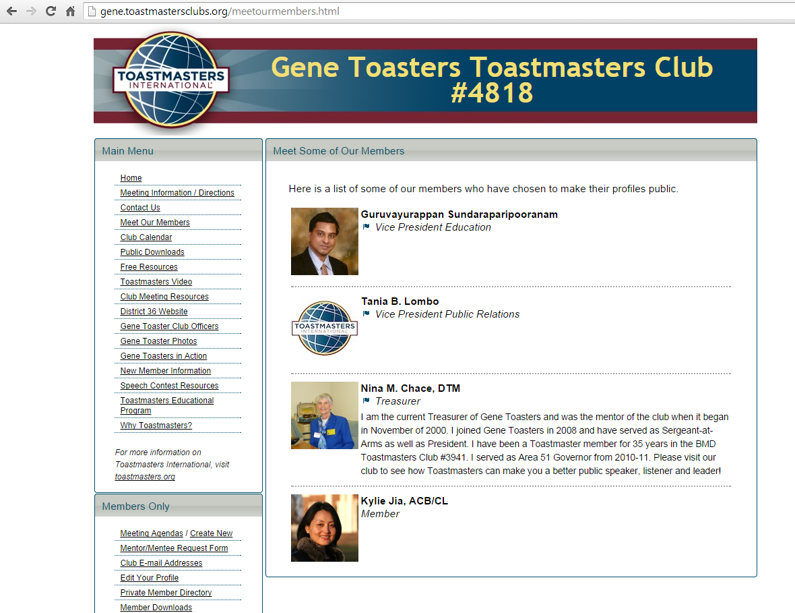
Not Just For The TMOD
Notes:
Do you recognize this website? I hope you do. It’s our club’s website. It has many resources for members other than the agenda including speech topics, table topic ideas, videos of member speeches, and information on the different meeting roles. Any information you want to know about TM, it’s probably on there. As a member of GT, there are even more website functions available to you and I encourage all of you to explore them. I know I will.

Slide 3
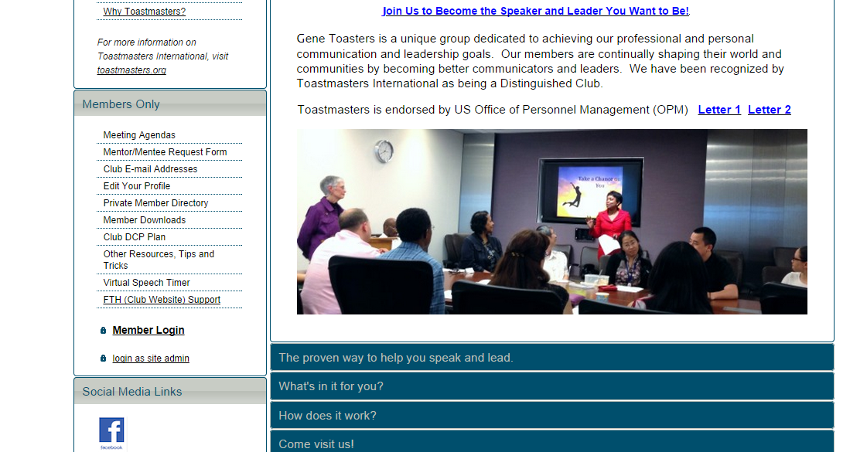
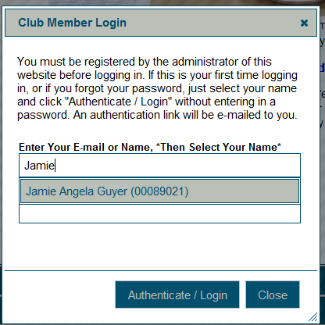
Members Only… Like VIP?…
Now you feel important, don’t you?
Notes:
To use many of these functions, you first need to sign in. After clicking on the Member Login link, begin to type your name and select your full name as it appears. If you are first signing in or have forgotten your password, select your name and click on “Authenticate/Login” without entering a password to receive a member verification email.

Slide 4
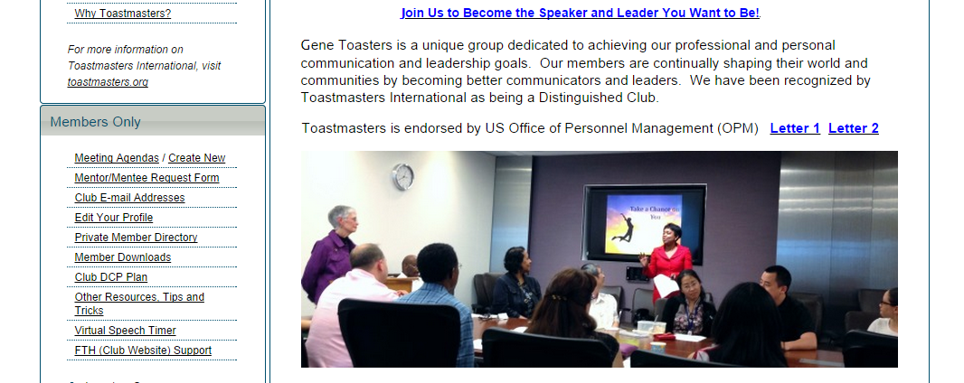
Notes:
Once signed in, I encourage you to take advantage of the members only resources available on the website including the meeting agendas.

Slide 5
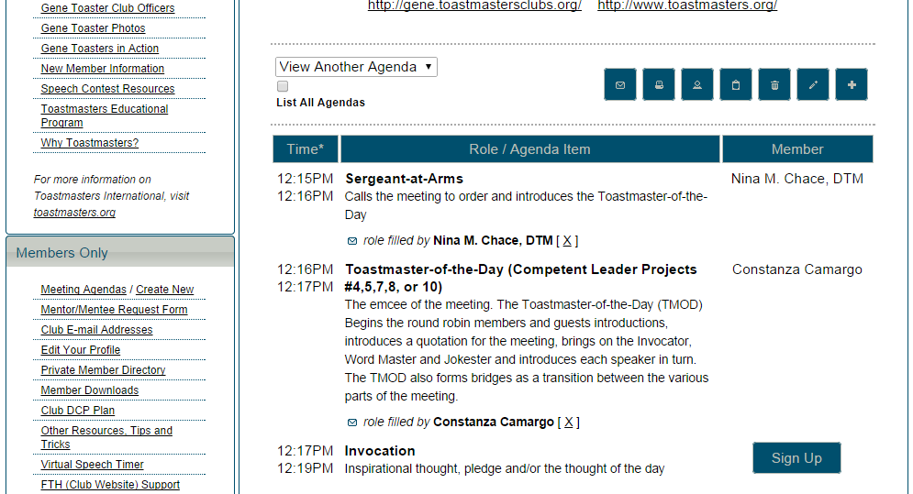
Notes:
The upcoming meeting agenda will be shown. To select another meeting date, pick your preferred date in the “View Another Agenda” drop-down menu. All of the meeting roles will be shown. You must click on the “Sign Up” button next to role you wish to fulfill. If you sign up as TMOD, you have the additional ability to edit the agenda even further and assign unclaimed roles.

Slide 6
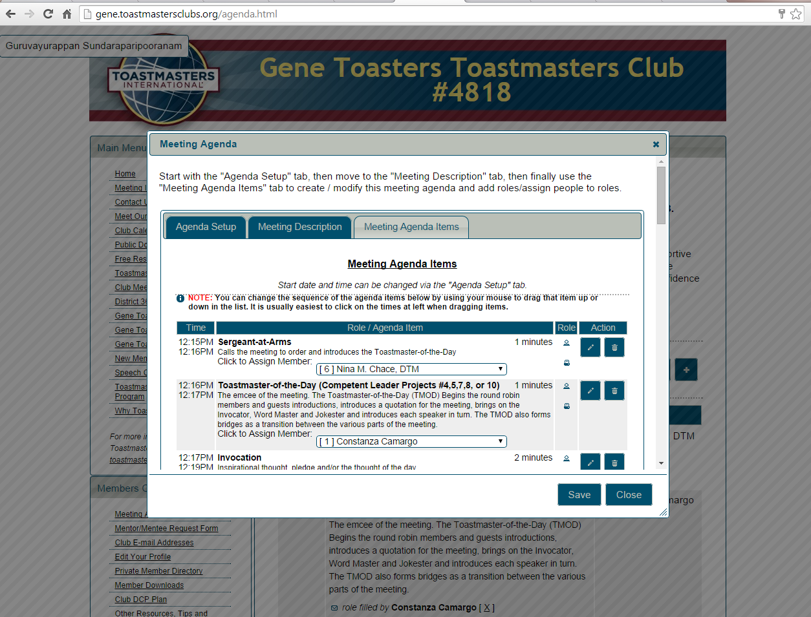
Notes:
Through the edit ability, you become a super Gene Toaster who can add or delete roles, change the role descriptions, and…. Assign roles to anybody you want!

Slide 7
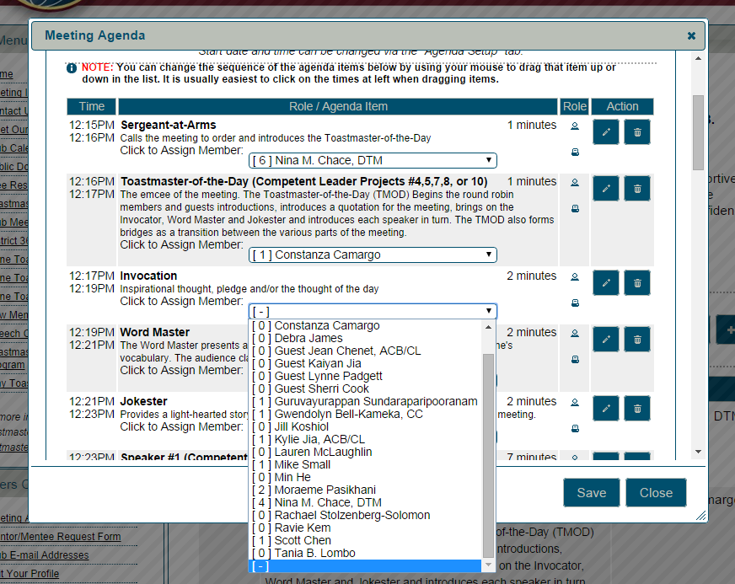
Notes:
Each meeting role will also be shown here. By clicking on the drop-down menu, all available member names will be shown including how many times they have fulfilled that role since the website was updated. Once you have made your changes and updates, don’t forget to hit SAVE or all your hard work will be lost.

Slide 8
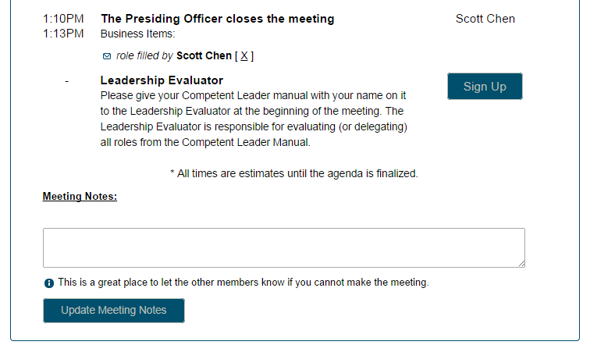
Notes:
People always say that communication is the key. One very useful agenda tool that anybody can add to is the Meeting Notes section located at the bottom of the agenda. This is a great place to let others know important information. For example, if I can’t make a meeting, I can let the club know by including it in the meeting notes. The TMOD will know not to assign me a meeting role.

Slide 9
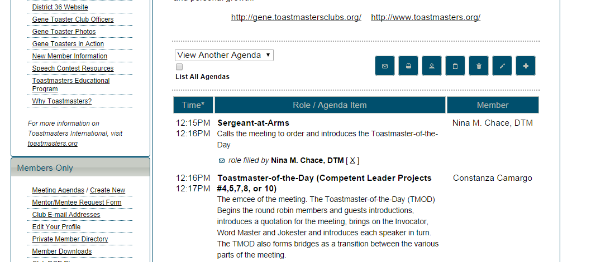
Notes:
Once you have saved and closed the agenda edit screen, you can email the draft agenda to the other club members and provide the meeting theme and any other information you would like to provide. It is suggested to send the draft agenda at least 1 week before the meeting to allow members time to consult their schedules and reply to you. Also, you may ask the speakers to include an introduction to you for the meeting. After any last minute changes have been made, you can print the agenda ready to hand out at the meeting. Congratulations, half of your job is done.

Slide 10
At the meeting
Hand out the printed agendas.
Make sure any needed equipment is available to your speakers and other members
Find someone to cover any last minute absences
Notes:
Once the room is set up, the agendas are handed out, and all the roles are covered, all you have left to do is to conduct the meeting.
An effective TMOD needs to be well prepared and organized to run a successful meeting. I would recommend this role to members who have been to a few meetings and have a good grasp on what is involved to carry out the different meeting roles. The website is designed well to support the TMOD, especially with creating the agenda. I encourage you all to explore the website and utilize its functions, especially the next time you sign up as TMOD.

Slide 11
Good luck! You’ll do great! ☺

